Slide 1
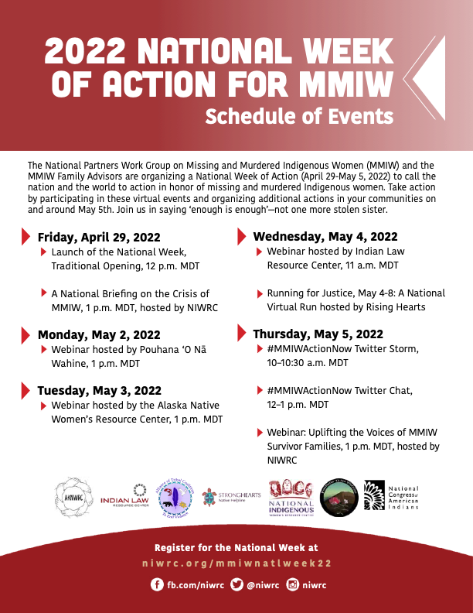
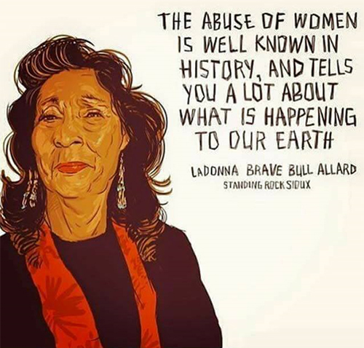
Have You Seen Me, 11/12/2022
National Resources
National Indigenous Women’s Resource Center (NIWRC)
National Indian Resource Center (NIRC) Addressing Domestic Violence and Safety for Indian Women.
NDNcollective.org
Dedicated to building Indigenous power through activism
National Indian Health Board
Largest health-focused group
Seeding Sovereignty
Urban Indian Health Institute
American Indian Women of Proud Nations
National Congress of the American Indians
MMIW Toolkit for Families and Communities
National Week of Action: May 29-April 5
Federal Resources
Open Cases
The FBI is seeking public assistance and information on the cases below, many of which involve missing or murdered victims in Indian Country.
https://www.fbi.gov/wanted/indian-country
Tribal Law and Policy Institute
Tribal courts, law enforcement, victim services/ MMIP, reentry services, and more
National American Indian Court Judges Association
Tribal Victim Services Set-Aside (TVSSA) funds can be used to support the family members of victims of MMIP. This funding can be used to generate awareness about their loved ones and cases
Call for assistance:
StrongHearts Native Helpline: 1-844-762-8483
Coalition to Stop Violence Against Native Women: 1-505-243-9199
Savannas Act
Savanna’s Act is a critical law because it aims to improve data collection and train law enforcement agencies on responding to missing and murdered Indigenous women (MMIW) and reporting data. However, according to the US Government Accountability Office, MMIW data analyses are in their early stages and the DOJ lacks a plan to continue these efforts.
Operation Lady Justice; A Presidential task force
Deb Haaland, U.S. Secretary of the Interior
Announced the formation of a new Missing & Murdered Unit (MMU) to provide leadership and direction for cross-departmental and interagency work involving missing and murdered American Indians and Alaska Natives.
https://www.bia.gov/service/mmu
U.S. Bureau of Indian Affairs
Office of Justice Services Headquarters1849 C Street NW, MS-3662-MIB, Washington, DC 20240
OJS_MMU@bia.gov
Read more on Savannas Act and the Not Invisible Act of 2019
https://indianlaw.org/swsn/savanna_not_invisible_laws
If you find the subject matter in discussion particularly troubling please feel free to reach out to: The Office of Spiritual Life Furman University: 864.294.2133
Mental Health Resources for the BIPOC community: https://liveanotherday.org/bipoc/
Notes:
NatiCatawba has tons of culturally specific resources (victim advocates, recovery support, counseling, IHS clinic, child care, and probably more). MMIW NC Coalition does a lot to raise awareness on Facebook and IG. The SC Coalition Against Domestic Violence and Sexual Assault (SCCADVASA) isn't culturally specific, but they are a phenominal organization and are strong allies. Their website is https://www.sccadvasa.org/
For national organizations, I recommend National Indigenous Women's Resource Center (https://www.niwrc.org/), Seeding Sovereignty (https://seedingsovereignty.org/), and Urban Indian Health Institute (https://www.uihi.org/projects/our-bodies-our-stories/).
For American Indian health resources-
United South and Eastern Tribes (USET) is a regional organization deeply involved in advocacy of health-related initiatives, especially on the federal level. Good resources are at this link: https://www.usetinc.org/departments/uset-spf/uset-spf-advocacy/health/
The Nation Indian Health Board is probably the largest and best known health-focused group. They have tons of resources on their site: https://www.nihb.org/
For justice resources
Tribal Law and Policy Institute covers a lot- tribal courts, law enforcement, victim services/ MMIP, reentry services, and more. Here’s the link to their publications tab, but their entire website has great stuff- https://www.home.tlpi.org/publications
National American Indian Court Judges Association- more focused on tribal courts- https://www.naicja.org/

